Slide 1
Research institute for statistics and information science (RISIS)
20-Nov-2025, GSEM faculty meeting

Slide 2
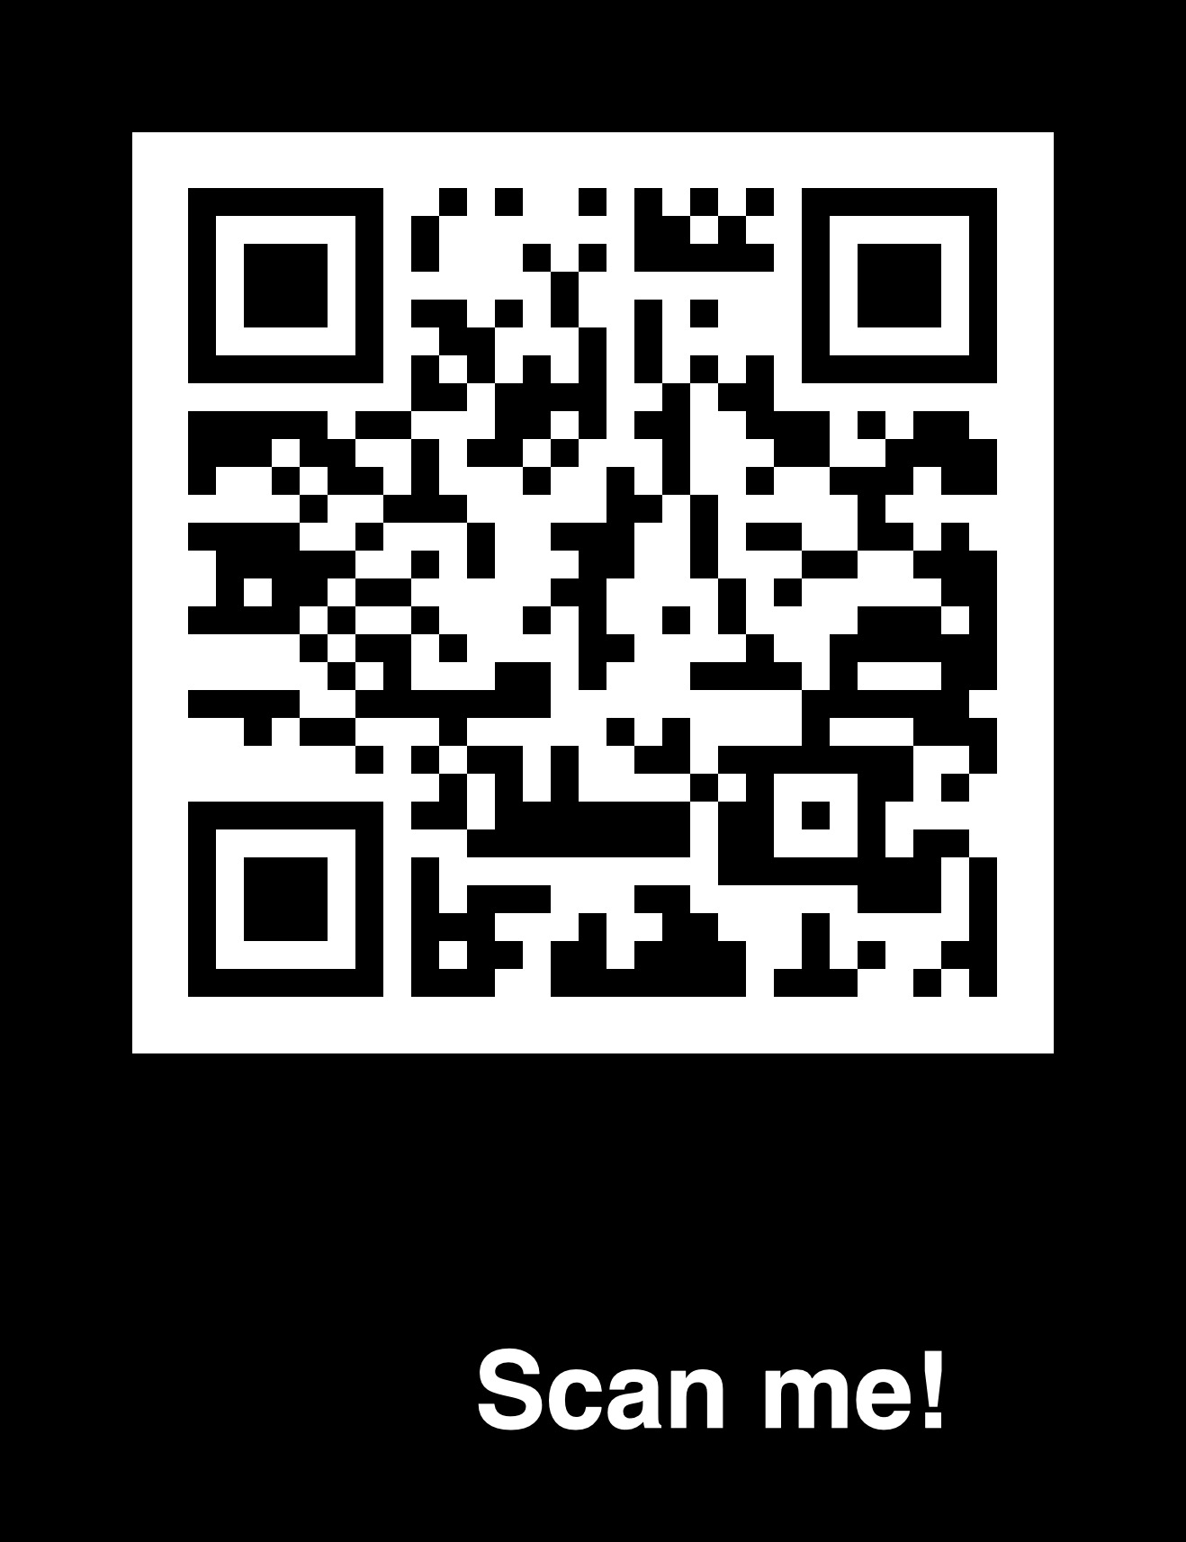
I’ll make use of the following color code:
Research in Stats
Research in Info Science
Teaching

Slide 3
PAST
Information Science Institute
(ISI)
Reseach Center for Statistics
(RCS)
Research Institute for Statistics and Information Science
(RISIS)
Jan 2024
Jan. 2024

Slide 4
Present
three members of RISIS won GSEM teaching awards
Teaching
Bachelor program at GSEM & GSI (& CUI): Maths I, Maths II, Prob, Stats, Stat Modeling, Prob and Stat Learning, Business Analytics, Numerical Methods, Statistical literacy and data skills for the SDGs, Algorithmique appliquée, Communication Networks…
two MSc programs (MaBAn & MaStat): Machine Learning, Time Series, Applied Bayesian Analysis, Modern Flex Regr, Analytics Consulting, Algorithmics and Data Management, Crowdsourcing and AI…
two Ph.D. programs (Stat and Info Science)
one interdisciplinary certificate program (CCSA)
one course in executive program
Three RISIS members won the GSEM teaching awards in 2025

Slide 5
Present
Research
- fundamental and applied statistics, machine learning (ML), analytics, and information science, establishing theory & methods that integrate statistics, ML, data analytics within various disciplines (economics, finance, management, medicine, informatics…)
- through collaborations with national and international research institutions, RISIS ensures that its innovations translate into practical applications
- RISIS members act in various cantonal, national, and international boards, like the Federal Commission for Statistics and FENStatsS (Federation of the European National Statistical Societies), and co-initiated and co-authored the Swiss Data Literacy Charter.

Slide 6
Present
Research
Publications (2024-2025): commitment to high quality

Slide 7
FUTURE
Goal: RISIS will sustain its role in research and teaching, it will keep working on theoretical and computational aspects of statistics, machine learning, data and information science, while enhancing its teaching tools
How: RISIS will foster interdisciplinary collaborations (GSEM, FPSE, Faculty of Science, Faculty of Medicine, BioTech Campus, GEM, Lusenti Partners, Nestlè, OFS); RISIS will strengthen connections between statistics, econometrics, machine learning, informatics, and data-driven science, while adapting its educational offer to align with evolving industry and academic demands

Slide 8


Magnifying the RISIS
Let’s have a closer look via a magnifying glass
and illustrate RISIS:
research and teaching activities,
projects of interest,
available skills,
tools or resources and,
other things that might be relevant to other institutes
(K. Preuschoff)

Slide 9
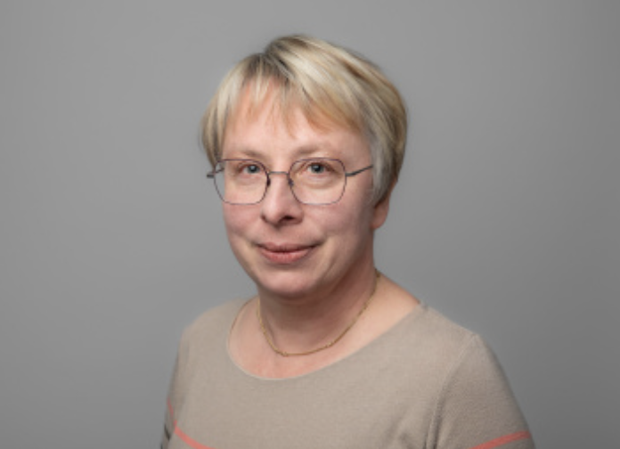
Eva Cantoni
Research: Modelling of and inference on datasets with complex structures: - univariate and multivariate data (often counts, but not only) with excess of zeros - random effects - robust alternatives
Keywords: ZIP and hurdle models, mixed models, GLM/GAM/GAMLSS models, single index models, latent variable models (GLAM), spatio-temporal models, state-space models. Applications in several fields, notably in ecology and medicine: “I like interdisciplinary collaboration and the challenge of knowledge transfer to other fields. I’m sensitive to dissemination, including software. If you have such structured data and want to collaborate, do not hesitate to reach out.” Teaching: Bachelor + Master: Prob & Stat Learning, Stat Modeling, Modern Flexible Regression; keen on pedagogical innovations (e.g. flipped class, use and assessment of (gen)AI for complete statistical analyses by students (MA)); won GSEM price for innovation in teaching.

Slide 10
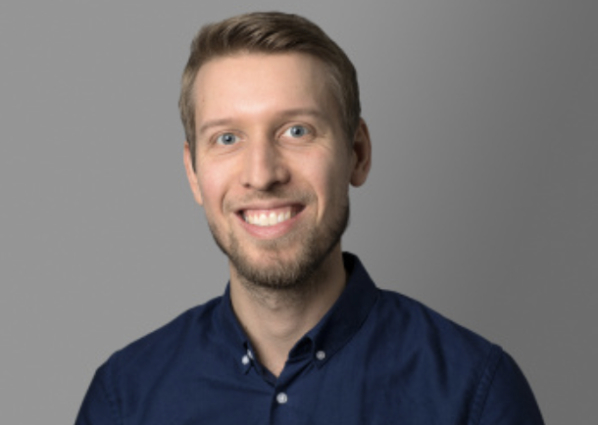
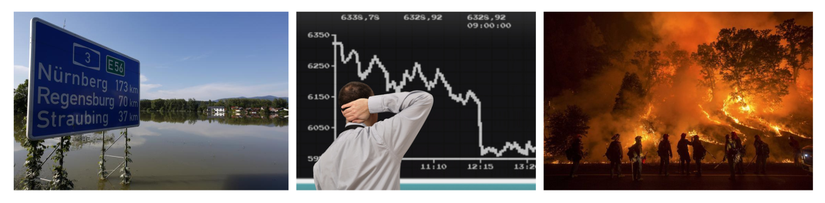
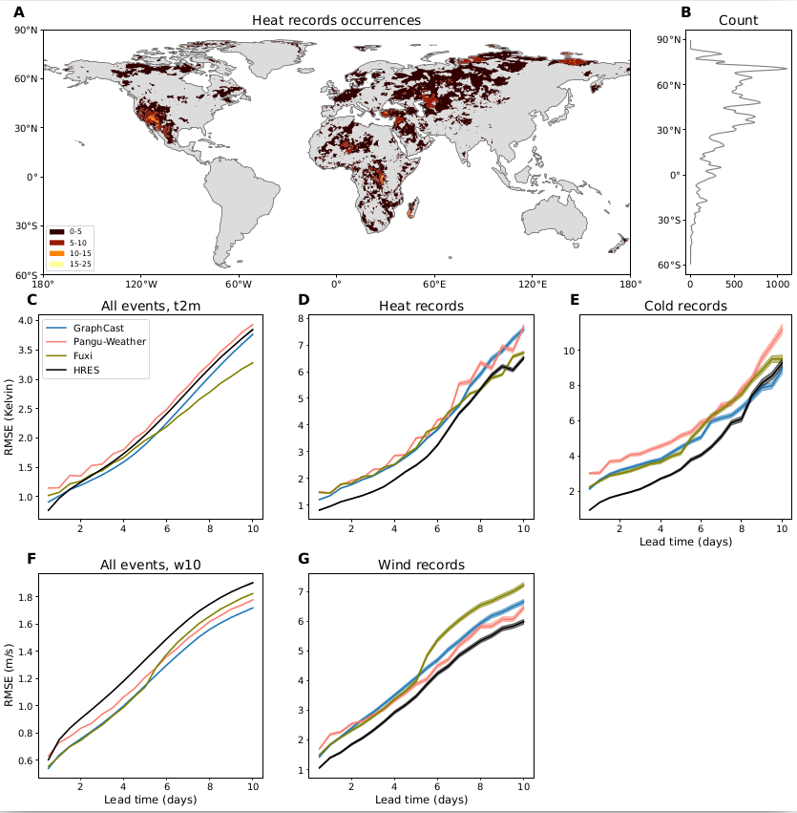
Sebastian Engelke
Research:
- Analysis of low-probability high-impact events (e.g., financial crises, floods, bush fires)
- Focus on learning graphs/networks representing dependence between different risks factors
- Applications range from systemic risks in bank networks to risks of climate extremes
AI weather and climate models: (a) we have infrastructure (GPUs) to run and finetune large-scale AI weather models (b) evaluate these models and compare them to traditional physical models; (c) focus is on extreme weather events and how well AI methods extrapolate.
Media coverage: https://www.bloomberg.com/news/newsletters/2025-09-01/ai-models-struggle-at-forecasting-extreme-weather-events?srnd=undefined
Notes:
"My research develops statistical methods that can be applied in several core areas within GSEM. The extreme value models for networks and graphs can be used to model risk of financial assets, banks, or climate extremes. The AI weather and climate models we study can be linked to impact models or to forecasting of renewable energies, for instance.
The line of research on AI weather models generates a lot visibility for GSEM, since I have been interviewed for the New York Times, Bloomberg and Tagesanzeiger.
My Master class on "Machine Learning" is attended by more than 70 students across institutes (and faculties) and introduces basics of AI methods. The "Advanced Topics in Machine Learning" covers reinforcement learning and large language models. Both classes thus contribute to the focus on AI in GSEM."

Slide 11
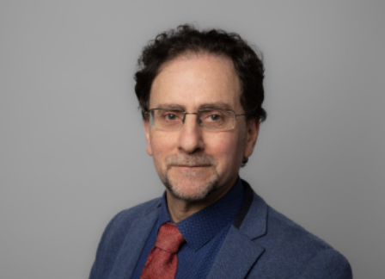

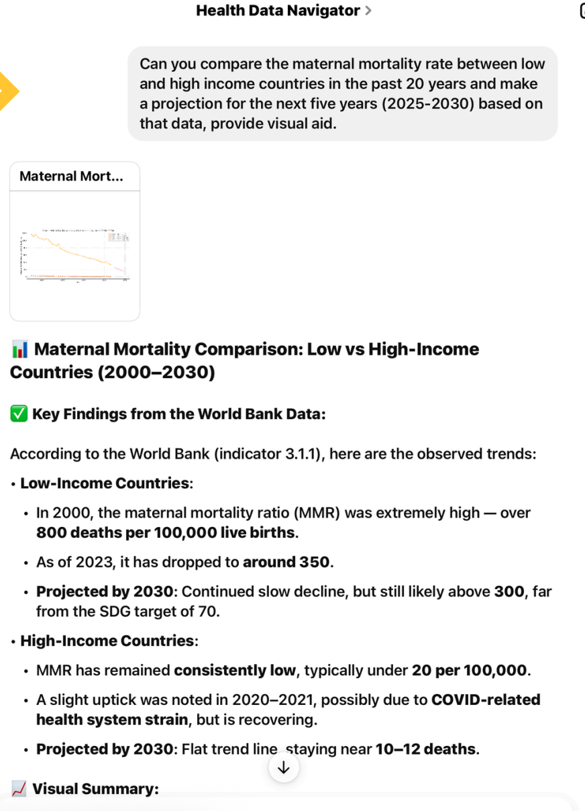

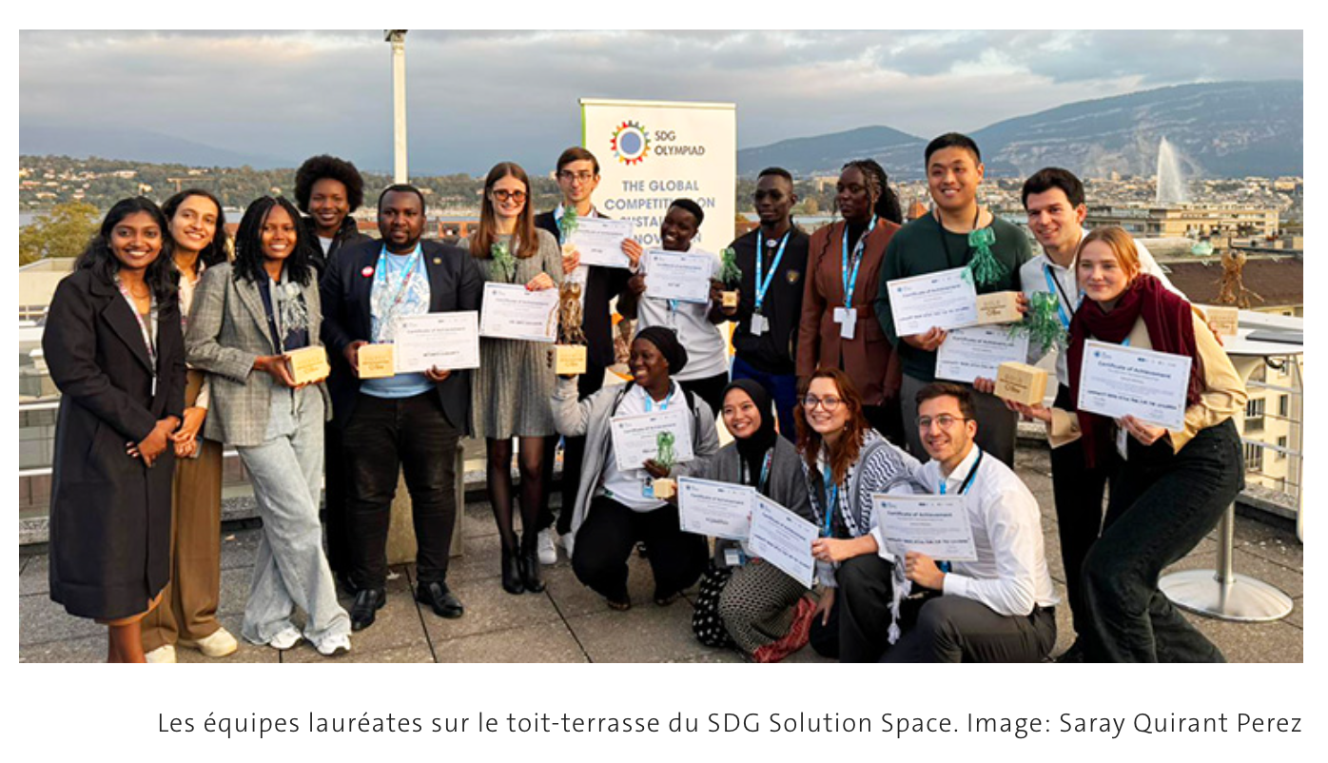

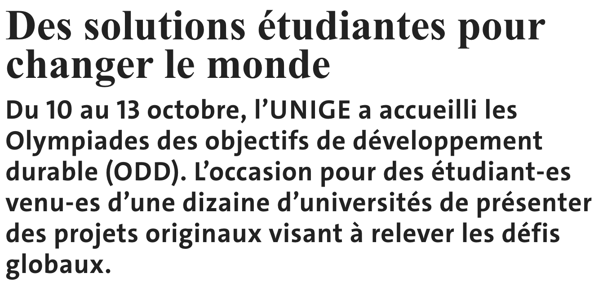
Francois Grey
Research and Teaching: Citizen Science (CS) for Sustainable Development Goals (SDG)
Student-Led Innovation: Prototyping an SDG chatbot
Student-Assisted Research: Preparing data for the chatbot
High-Impact Publication: Documenting the results
Conference paper accepted for ECSA 2026 Conference in Oulo, Finland, 2-7 March 2026 “Innovation management for Citizen Science : what we've learned from the SDG Olympiad”
Article to be published in inaugural issue of this new Nature journal in January 2026:
Citizen science is now essential for official statistics. D. Fraisl, L. See, S. MacFeely (OECD), I. Moorthy, G.-S. Ulrich (Federal Statistical Office of Switzerland), O.Seidu, F. Grey, S. Schütz & I. McCallum.
Part of EU project ALBATROSS
Practical Application
Notes:
Citizen Science for the SDGs
Summary: The slide outlines how GSEM bachelor students have helped to develop an AI tool for navigating data related to the SDGs. This is an example of “Citizen Science”, which is the focus of my team’s research. The story starts from the SDG Olympiad, a student innovation competition held in October, where a GSEM bachelor student was part of a team that won a prize for developing a prototype chatbot called “SDG Data Navigator”. The story continues with GSEM bachelor students in my course on Statistics and Data Analysis for the SDGs helping to add new data sets to the LLM that powers the SDG Data Navigator. Finally, results from this kind of student-driven research will be presented at an international conference on Citizen Science in March and related results will be published in the inaugural issue of a new Nature journal. The SDG Olympiad benefitted from a collaboration with colleagues at IOM, notably Marcel Paulssen and Christina Hertel.
Background
My team’s area of research is Citizen Science (CS), or crowdsourced research, with a focus on the development and use of digital platforms for gathering and analysis by citizens of data that is relevant for the SDGs.
(In case you are wondering, the term ‘citizen science’ normally describes amateur scientists, ie people not doing science as a paid profession. This can range from teenagers doing a high-school science project - UNIGE’s BioScope project CodeMyPlant is a good example - to nonagenarian amateur ornithologists gathering data about birds on platforms like iNaturalist. CS covers a wide range of sciences, from particle physics to medical research, and includes science done by bachelor and master students, since they are not professional scientists. PhD students are hired to do research and so qualify as professionals.)
My team is participating in an EU project called ALBATROSS focussed on research and innovation for climate change adaptation, where our main deliverable has been organizing a global competition called the SDG Olympiad. The purpose is to encourage students in Europe and around the globe to use CS to gather and analyse data that helps National Statistical Offices (NSOs) to track progress towards the SDGs.
This year’s second edition of the SDG Olympiad was held at the SDG Solution Space at Campus Biotech on 10-13 October, and hosted top teams from SDG Summer Schools at 14 universities on four continents, as detailed in the Journal de l’UNIGE article shown in the slide.
One of those teams, which was formed at the SDG Summer School held in Geneva in July, involved a Bachelor student from the GSEM, Anastasiia Rytseva (sixth from the left in the photo) who won a special Tech for Impact Prize at the Olympiad. This was awarded by an independent jury including UN representatives. The prize was for her team’s project entitled SDG Data Navigator. Anastasiia’s team was coached by one of my PhD students, Saray Quirant Perez, responding to a challenge set by Hannah Redders, the manager of a Geneva-based NGO called Data for Change, which is an OECD spinoff.
The challenge set by Data for Change was to provide NSOs with a chatbot interface to query collections of open data sets published by UN agencies and other authorities that are relevant to specific SDG indicators. Anastasiia’s team focused on building a chatbot for open data on health (SDG 3), shown in action in the central panel. Her team ensured that the data can be queried accurately, using an LLM built with relevant data and metadata only. An AI expert from Northeastern University coached the team on building the LLM and chatbot and testing it with suitable benchmarks.
Thanks to help from Marcel Paulssen, the SDG Summer School that Anastasiia participated in will provide her with 6 ECTS as a GSEM Institutional Project. Five other GSEM students participated in the SDG Summer School.
The next phase of the research for the SDG Data Navigator will be carried out by students in my Bachelor course on Statistics and Data Analysis for the SDGs. This is a 6 ECTS course, with 15 students participating this semester. I introduced this course last year at the request of our Institute Director, Stefan, to motivate GSEM bachelor students to take more advanced stats and data science classes and consider applying for the Masters in Statistics or Business Analytics. Sebastian Engelke is a guest lecturer in the course.
As part of the course, GSEM bachelor students learn how to clean data sets with various tools (R Labs, Google Colab, Power BI). One of the exercises is to prepare data sets that can extend the usefulness of the SDG Data Navigator beyond health data, using data from sources like Humanitarian Data Exchange (HDX), a UNOCHA initiative. Saray is assisting on this course and Hannah will be mentoring the students during this activity.
The final phase of this research will be to document the use of Citizen Science in the SDG Olympiad, which will include the example of the SDG Data Navigator, in a conference paper that has recently been accepted for a session on Innovation Management at the top European Conference on Citizen Science, ECSA 2026, which will be held in March at the University of Oulo in Finland. As noted on the slide, the paper is entitled “Innovation management for Citizen Science : what we've learned from the SDG Olympiad”.
As for the future of the SDG Olympiad, a team of Master students is spinning off this competition as part of a stand-alone association called “The Sustainability League” that will organise and fundraise for future editions. This is with the support and expert advice of Christina Hertel and her team at the Geneva Responsible Entrepreneurship Center (GREC).
I also include in the slide the title and author list of a closely related article that will be published in January in the inaugural issue of a new Nature journal called Communications Sustainability. This article, entitled “Why Citizen Science is now essential for official statistics”, features co-authors from the OECD and the Federal Statistics Office of Switzerland. It argues for the wider adoption of Citizen Science methods to tackle the widening data gaps that many countries are facing due to the massive cuts in humanitarian and development programs by the US and many other countries.
At the risk of overloading you with background information, I note that the lead author on this article, Dilek Fraisl, is the managing director of the Citizen Science Global Partnership (CSGP), an association representing a network of regional Citizen Science associations, which was co-founded by UNIGE in 2023. The CSGP’s mission is to promote the use of Citizen Science data by UN agencies and international NGOs. Together with partners from University of Zurich, we host a Geneva hub for the CSGP at the SDG Solution Space, co-funded by a Swissuniversities project called “Citizen Science Connected” and an EU project called “Research Infrastructure for Excellent Citizen Science”.

Slide 12


Diego Kuonen
Activities at UNIGE and outside include:
- Founding Director of the Master of Science in Business Analytics and director of CCSA
- Since 2001, CEO at Statoo Consulting
- Current main job: “Trusted Strategic & Tactical Advisor” in the field of data and analytics to executives
- Credo: bridge the gap between professional business management practice and academic research
- Won 2023 Søren Bisgaard Award of the Statistics Division of the American Society for Quality (ASQ)
- Member of the Board of Directors at the Digital Law Center, Faculty of Law (since 2020)
- Current topics (in operationalisation and implementation at clients):
Data & Analytics (including AI) Governance (e.g., holistic, human-centric, trustworthy, principles-based, purpose-driven)
Chief Data & Analytics (including AI) Officer as a Service (CDA(I)OaaS)
Data & Analytics (including AI) Product Lifecycle Management
Analytics-ready Data and AI-ready Data (e.g., AI readiness)
Teaching:
Bachelor + Master + Executive program: Business Analytics, Analytics Consulting, Data Quality and Data Collection Strategies -- keen on pedagogical innovations won GSEM price for innovation in teaching

Slide 13

Davide La vecchia
Research:
- Inference on stationary and nonstationary time series
- Learning random fields over nodes/edges of networks/graphs in the presence of latent factors
- Applications: economics (gravity model for flows over the edges) and medicine (EEG, fMRI for time series on nodes)
- Robust Machine Learning via optimal transport (e.g. for Generative Models or Image Analysis)
Teaching: Bachelor + Master: Prob 1, The Statistical Analysis of Time Series, Theoretical Statistics, Teaching Statistics.

Slide 14
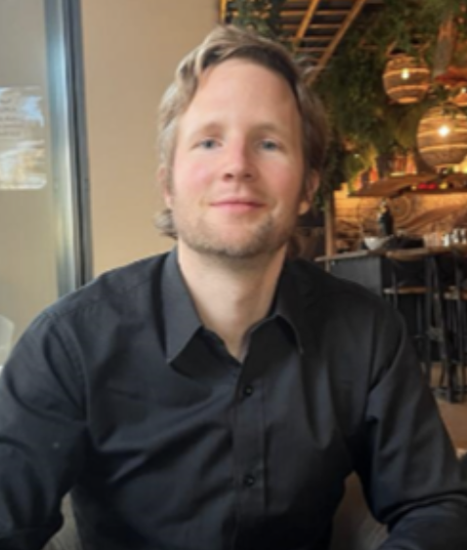
JEFFrey NäF
Research:
- Distributional Prediction/ Random Forests and Kernel methods
Developing specialized Random Forests that learn complex objects, such as the joint conditional distribution of variables of interest given predictors
Distributional Random Forest (DRF) and Causal Distributional Random Forest (Causal-DRF). Both use the concept of kernel mean embeddings to efficiently learn representations of (multivariate) conditional distributions
- Missing Values
Studying and developing best practices in Missing Value Imputation
Theoretical work, treating the problem of missing values as a problem of misspecification and using tools from robust statistics
In general, I am attempting to close the gap between theory and practice in the handling of missing values
- Applications in Marketing Science (Analytics) and Economics
Developing powerful and useful models to predict and analyse the Customer Lifetime Value
Providing professional implementations, such as in the R package CLVTools, to make the models widely useable
Currently, we apply DRF to inflation prediction in joint work with collaborators from the European Central Bank
Teaching: Bachelor + Master: Maths 1, Forecasting with Applications in Business
Notes:
The first point is about my work on forests that learn conditional distributions via kernel embeddings. As this is very widely applicable, I am always looking for new interesting applications.
Then I mention my current work on missing values, which spans more applied work on how to impute i.i.d. datasets correctly and also a bit more theoretical work on how to use methods from robust statistics to guard against the unknown missing value process. This could be interesting, as this is a problem everybody has, and I am always interested in learning about the kind of problems that people face in applications.
Finally, I also mention an application of DRF to inflation prediction and my work in Marketing Science which is jointly with Markus Meierer.

Slide 15
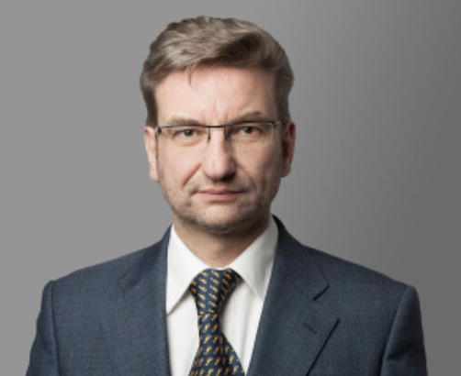
STefan Sperlich
Research:
- Non- and Semi-parametric inference in Generalized Structured Models
“There are certainly different definitions of what that means or implies. In my own research it almost always refers to the approach of imposing a model structure such that you can easily derive interpretable parameters of functions from your estimation methods. ’’
More in detail: (a) additive and multiplicative hazard models for risk and survival analysis (collab with Faculty of Medicine); (b) Data-driven impact evaluation of heterogeneous effects (explain how, for whom, and under what circumstances an intervention works, using a causal graph); (c) Semiparametric factor and gravity models for panel data
- Advanced Inference in Mixed Effects Models
Statistical properties of estimators/tests when heterogeneity is modelled by Random Effects: (a) For estimation in small areas or small clusters (conduct inference on small samples using auxiliary info); (b) Cross factor experimental designs with several fixed and random effects (collab with FPSE); (c) Post-selection ‘selective’ inference with mixed effects models
Notes:
“Making highly flexible methods interpretable” There are certainly different definitions of what that means or implies. In my own research it almost always refers to the approach (in estimation) of imposing a model structure such that you can easily derive interpretable parameters of functions from your estimation methos.
Additive and multiplicative hazard models for risk and survival analysis
So here the hazard function is typically decomposed in a baseline hazard h_0 which only depends on time t, and another h_1 (in practice typically linear model) which depends on some observed covariates Z, i.e. h_1 = Z’beta but could be nonparametric, e.g.
h(X) = h(t,Z) = h_0(t) h_1(Z) respectively h_0(t) + h_1(Z)
or fully multiplicative / additive h_1(Z) = prod_j h_j (Z_j) or = sum_j h_j (Z_j)
Thesis project of Dongmei Liu in cooperation with Uni Copenhagen. Related thesis project with faculty of Medicine.
Data-driven impact evaluation of heterogeneous effects (realist evaluation)
In evaluation theory, realist evaluation is a theory-driven approach that explains how, for whom, and under what circumstances an intervention works [supposing you classify ‘who’ and ‘circumstances’ by observable covariates]. This requires a so-called impact model that you preferably describe by a causal graph (a DAG), from which you can derive nonparametric identification in a constructive way, i.e. you see from the identification how to estimate it. We are looking for as-much-as-possible or necessary data-driven non/semiparametric frameworks.
D.J. Henderson and S. Sperlich (2023) A Complete Framework for Model-Free Difference-in-Differences Estimation. Foundations and Trends® in Econometrics
G. Benini, S. Sperlich (2022) Modeling Heterogeneous Treatment Effects in the Presence of Endogeneity. Econometric Reviews
Semiparametric factor and gravity models for panel data
For instance, you may want to estimate y_it = x_itβ + m (λi, f_t) + u_it with semiparametric function m(.) of latent factors and loadings
Another example is estimation of varying coefficient models like
E(yijt| xijt, αit, γjt, ηij) = λijt = exp ( αit + γjt + ηij + xijtβ)
with αit, γjt smooth in time, β smooth in time or any other moderator
Present Projects with Spanish Research Grants
“when Heterogeneity is modelled by Random Effects” essentially means that we consider linear or generalized linear mixed effects models
For estimation in small areas or small clusters (e.g., mixed effects models based or -assisted simultaneous inference for many small samples)
The complexity comes from the use of the predicted random effects when estimating/predicting small area or cluster parameters like cluster mean, or poverty in a small area etc. The inclusion of those random effect predictors renders the standard error estimation complicated. You further have to decide if you want to do inference just cluster-wise or simultaneously (for all or several clusters/small areas).
Theses of Katarzyna Reluga and Peter Kramlinger (Uni Göttingen) – various papers, including 2 JASA
Cross factor experimental designs with several fixed and random effects
Working out the exact asymptotics for classical ANOVA models with several fixed and random effects in contingency tables. Surprisingly, while software exists, expressions for the asymptotics did not.
Thesis of Patrick Schöngrundner (at FPSE)
Post-selection ‘selective’ inference with mixed effects models
How to do correctly inference on both, model parameters and cluster or small area parameters when first a data-driven model selection had taken place in a linear mixed effects model for selecting the covariates that were used for the estimation/prediction?
Project with Katarzyna Reluga and Gerda Claeskens (Uni Leuven)
Related projects with Christophe Valvason and Silvia Scarpa (thesis at Uni Padova)

Slide 16
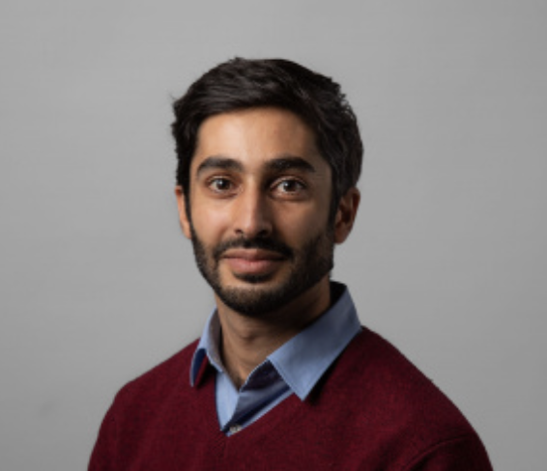
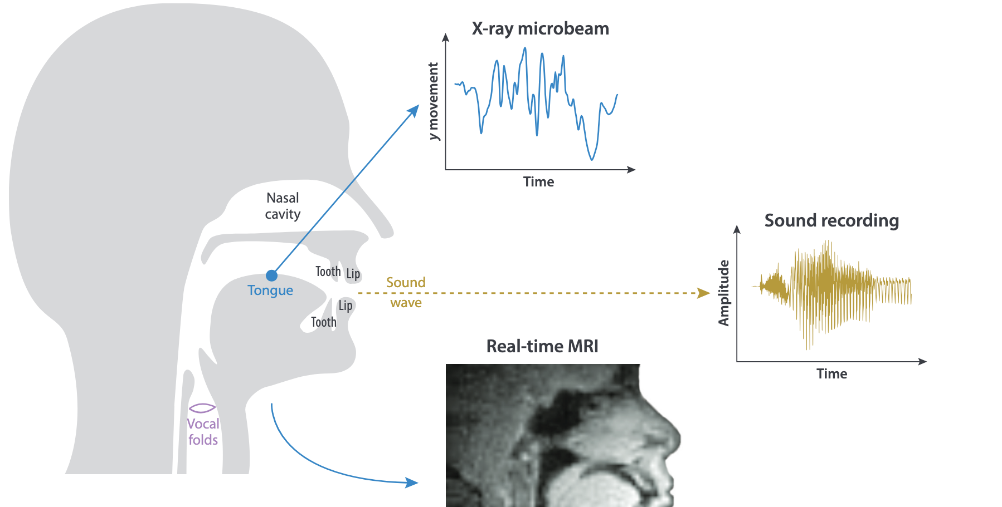
SHahin Tavakoli
Research:
- Functional Data Analysis (FDA): analysis of data that are curves (or images, sounds…)
- Theory & Methods (functional time series, factor models, regression models…). Applications: (neuro-)imaging; phonetics; biophysics; econometrics; genomics; customers analysis based on complete behavioural trajectories (purchase patterns, engagement curves, clickstream journeys); data from sensors and digital systems
Teaching:
Bachelor + Master: Maths 1 (GSEM + BARI), Multivariate Analyis, Applied Bayesian
Analysis --- keen on pedagogical innovations (jigsaw method)
Notes:
# Shahin Tavakoli
## Research
Shahin Tavakoli's expertise is in Functional Data Analysis (FDA). FDA is a statistical framework for analyzing data that naturally take the form of curves, images, sounds, or other continuous objects rather than isolated scalar measurements. FDA has a wide range of applications, such as econometrics, finance, phonetics, biophysics, genomics, to name only these. Shahin Tavakoli has expertise in functional time series, factor models, and regression models.
Within econometrics, FDA models economic and financial phenomena as continuous functions rather than isolated points, enabling forecasting of complex relationships that evolve over time. In management and marketing contexts, FDA can segment customers based on behavioural trajectories—including purchase patterns, engagement curves, and clickstream journeys—rather than summary statistics, providing more granular market insights. Additionally, FDA addresses the challenge of high-frequency, high-dimensional data from sensors and digital systems by reducing dimensionality while preserving temporal structure, facilitating applications in real-time monitoring, anomaly detection, and forecasting in information-intensive environments.
## Teaching
Shahin Tavakoli teaches
- for the GSEM and the BARI BSc: Mathématiques 1
- for the MSc in Statistics: Multivariate Analysis and Applied Bayesian Statistics
In Mathématiques 1, Shahin provides GSEM students with the essential mathematical foundations that underpin all of their technical coursework.
In the MSc in Statistics courses, he teaches advanced statistical methods and the theoretical principles necessary for rigorous understanding. These courses develop both methodological competence, practical competence, and the conceptual framework needed to grasp more sophisticated statistical and machine learning models.
## Service
Shahin Tavakoli serves as Associate Editor of the Journal of Statistical Planning and Inference.
He also represents the University of Geneva on the Conseil cantonal de la statistique (Canton of Geneva).

Slide 17
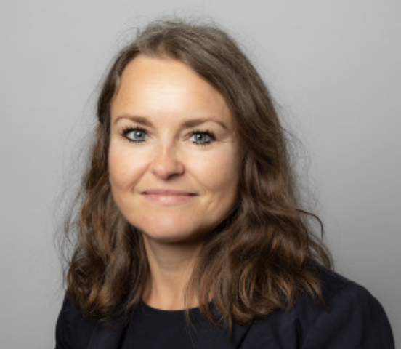
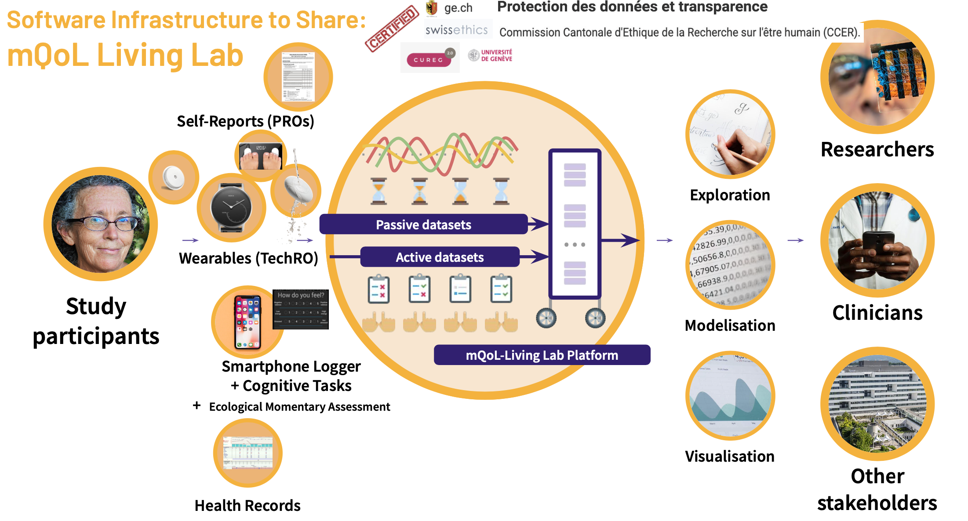

Katarzyna WAC
Research:
- Quantifying Quality of Life via Human-Centric AI Research
More in detail: looking at different domains (Physical health, Psychological aspects, Social relationships, Environment), we precisely define (via human centric methods), accurately capture (via smartphones/wearables), statistically analyze (using methods including AI), and clinically validate (in healthy/diseased populations) 16 (for now) of 24 variables contributing to life quality
Teaching:
Bachelor + Master. How to code (Python, JAVA, C, C++, R, ...); What is a digital service from data to value proposition: stats/ML/AI; communications & networking (client/server); computing & databases, context (PESTEL). How to conceptualize, design, build, validate and pitch a digital service

Slide 18
Thanks

